Slide 1
Google Playstore – Apps Maintenance & Marketting Analysis
Power BI Dashboard Project
Name: Namitha K
Data Analytics

Slide 2
Introduction
The Google Play Store contains a wide variety of applications across multiple categories
Understanding category-wise app distribution helps identify market saturation
Install trends indicate user demand and popularity of applications
Ratings and review counts reflect user satisfaction and app quality
The comparison of free vs paid apps highlights monetization strategies
Update trends over time show the importance of app maintenance
This Power BI dashboard provides interactive insights to support data-driven decisions

Slide 3
Objective Of The Project
To analyse the google playstore application.
To check app distribution over Categories.
To study user behaviour towards Install & Ratings.
To evaluate Free Vs Paid apps.
To bulid an interactive dashboard using Power BI.

Slide 4

Data Set Overview
Data Set Details
Source : Google Playstore Apps
Total Records : ~2.3 Million
Key Columns : App Id
App Name
Categories
Installs
Ratings
Rating Count / Reviews
Free Apps
Paid Apps
Content Rating
Last Date Updated

Slide 5
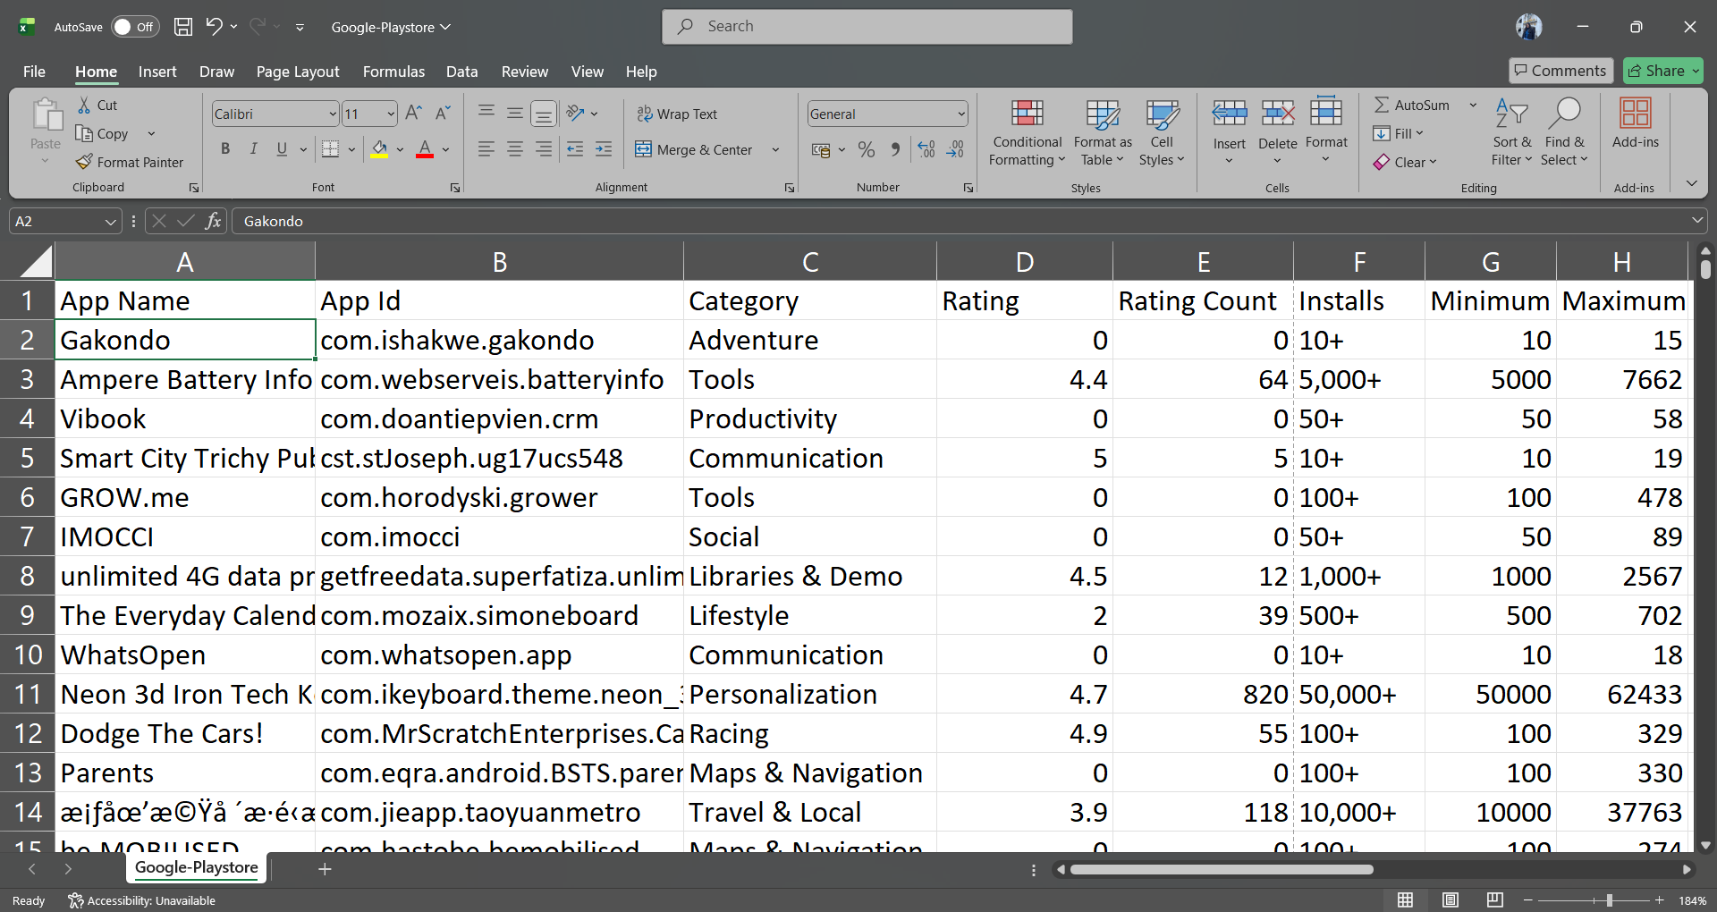
Dataset

Slide 6
Tools & Techniques Used
Tools Used
Power BI : It is a data visualisation tool used to show the operations in charts form ,raw data meaningfull insights.
Power Query Editor : It is the place where we transforms the data ,clean the data.
DAX Measures & Calculations
Jupyter Notebook
Techniques
Data Transformations
KPI Calculations
Visual Analytics
Interactive Slicers
Data Cleaning

Slide 7
Analysis Criteria Used
Total Apps by Category – to identify market saturation
Total Installs by Category – to understand user demand
Average Rating by Category – to measure app quality
Rating vs Installs – to analyze user engagement patterns
Free vs Paid Apps – to study monetization strategies
Apps Updated Over Time – to understand maintenance trends

Slide 8
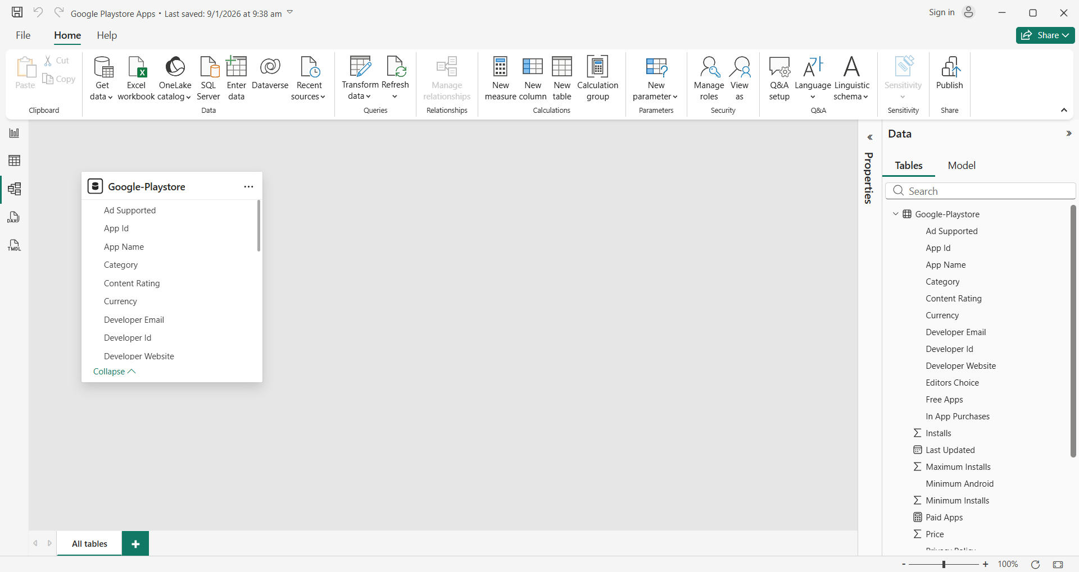
Connections

Slide 9
Charts Used
KPI’s : To get the overall performance of the app
Stacked Bar Chart : Used to compare application distribution across categories
Clustered Column Chart : Used to analyse Total installs by Category
Donut Chart :Used to shoe the proportion of free apps Vs paid apps
Line Chart : Used to analyse apps updated over time
Slicer :Used to filter data by category, content rating, app type( free /paid), and year
Scatter Chart : Used to analyse the relationships between ratings and installs
Table :Used to display category-wise ratings and app details
Line & Stacked Column Chart :Used to compare installs and ratings together by category

Slide 10
Analysis
Apps by Category Analysis
Education & Business in high demand.
Tools & Entertainment dominate the installs.
Rating & User Engagement
Higher installs generally correlate with higher ratings.
Some low-install apps still maintain high ratings.
Monetization Analysis
Majority of apps are Free Apps.
Paid apps form a smaller percentage.
Free apps rely on ads & in-app purchases.
Install & Maintenance Trends
Popular categories show consistent updates.
Frequently updated apps gain better engagement.

Slide 11
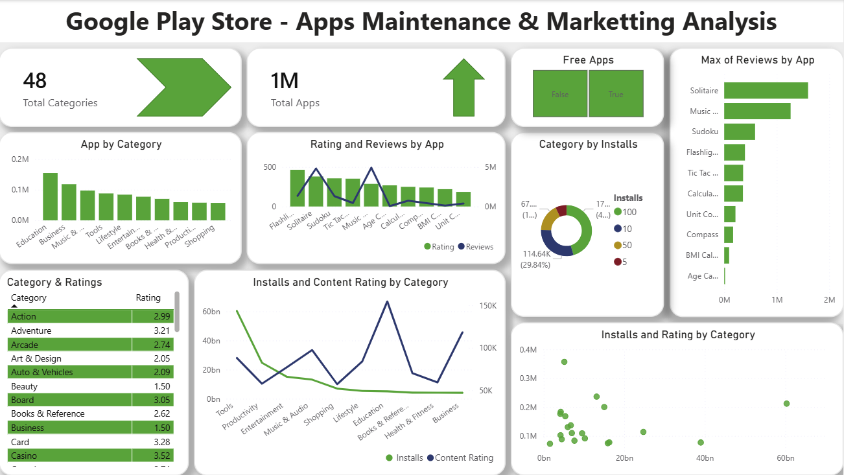

Slide 12
Suggestions
The analysis can be enhanced by adding time-based trends to study seasonal growth in app installs
User sentiment analysis from app reviews text can be included to better understand user feedback
Revenue-related fields such as in-app purchases and ad earnings can be integrated for deeper monetization insights
Predictive analysis can be implemented to forecast future installs and ratings
Country-wise or region-wise analysis can be added to understand geographical app performance
App update frequency can be analyzed to measure its direct impact on ratings and installs
Advanced Power BI features such as drill-through and bookmarks can be used for deeper exploration

Slide 13
Conclusion
Free apps dominate the Google Play Store.
Category & install trends guide market strategy.
Ratings and reviews strongly influence installs.
Power BI enables interactive and insightful analysis.
This dashboard helps stakeholders make data-driven decisions in app development and marketing.

Slide 14
References
Kaggle Datasets : https://www.kaggle.com/datasets/gauthamp10/google-playstore-apps
Power BI

Slide 15
THANK YOU
Gmail : pramodnamitha954@gmail.com
LinkedIn
Github

